Slide 1
Best Practices
Membership Committee

Slide 2
Membership Committee Best Practices
Goal | Initiative | Outcome
Improve email orientation for new members monthly | Standardized AFCEA NOVA Welcome email with use of CRM to establish strong first impression and answer key questions | New member email has high level of engagement and is shared with non members, open rate consistently above Gov Industry average
Expand engagement of AFCEA members into Dulles Corridor | “AFCEA Is Coming to You” campaign Partnered with Dulles Chamber to collaborate on bringing valuable GovCon networking to the Dulles Innovation region | High level of enthusiasm and engagement with individual and corporate membership, attendance averages 35-40, generated buzz about AFCEA
Personal interaction with new members | Emails link to VP of Membership, each expression of interest is followed up with personally with coffee meeting, phone call or email, embedded video welcome from Chapter President, Tamara Greenspan | 10+ people have been matched with members of the Board for engagement with committees.
Data Mining for improved engagement | Track and analyze data from CRM and attendance to better inform future activities in membership | Improved welcome email – added more relevant links, able to target specific zip codes for HH attendance, increased engagement in Fairfax region
Maximizing personal touch | Involve board members in outreach activities to validate value of AFCEA membership, partnering with chamber creates a larger warm market | Added substance to the HH environment, helps qualify leads for involvement in committees
Social Media promotion | Post on LinkedIn about Happy Hours and the benefits of membership | Average posts gets over 1000 views and has also helped to generate buzz for AFCEA

Slide 3
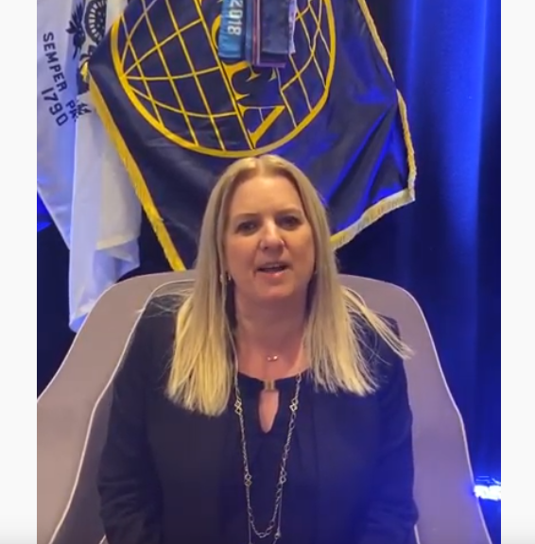
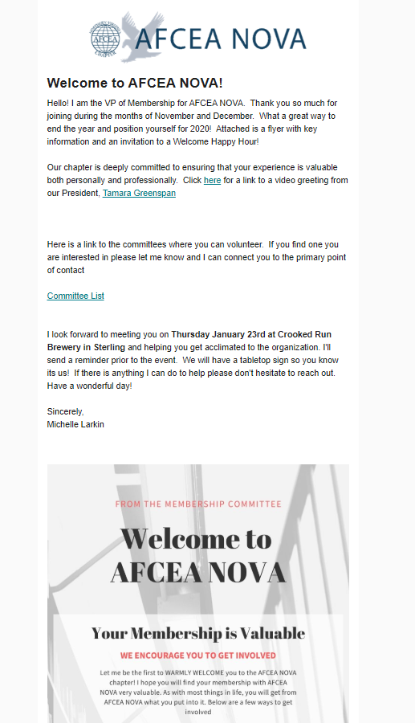
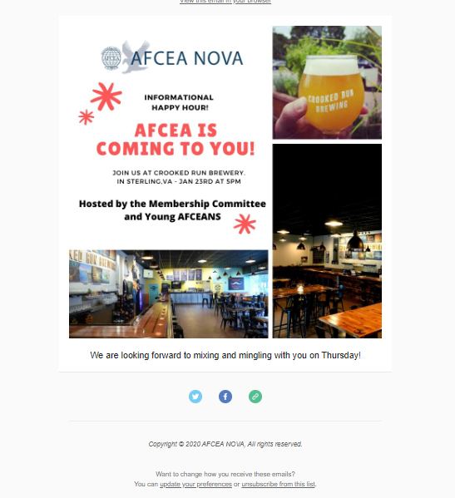
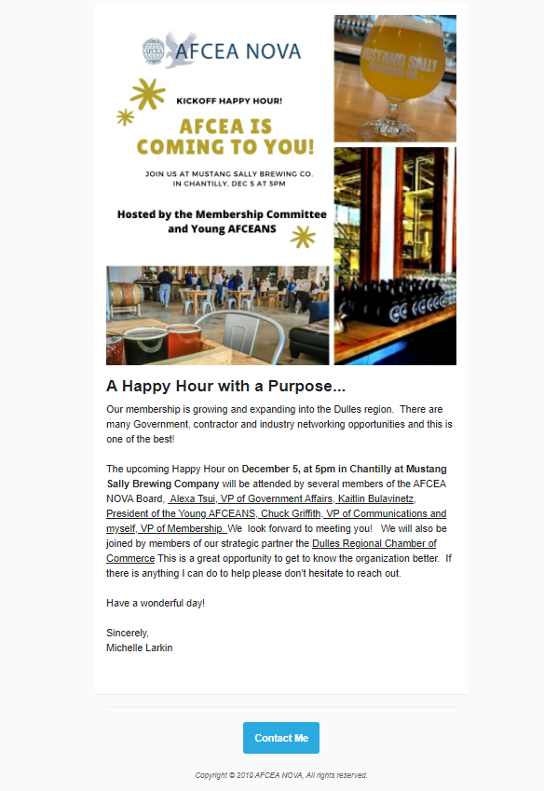
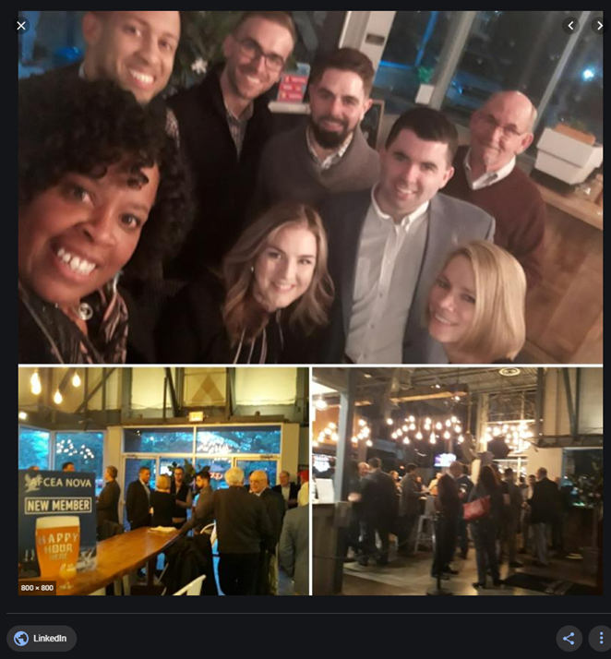
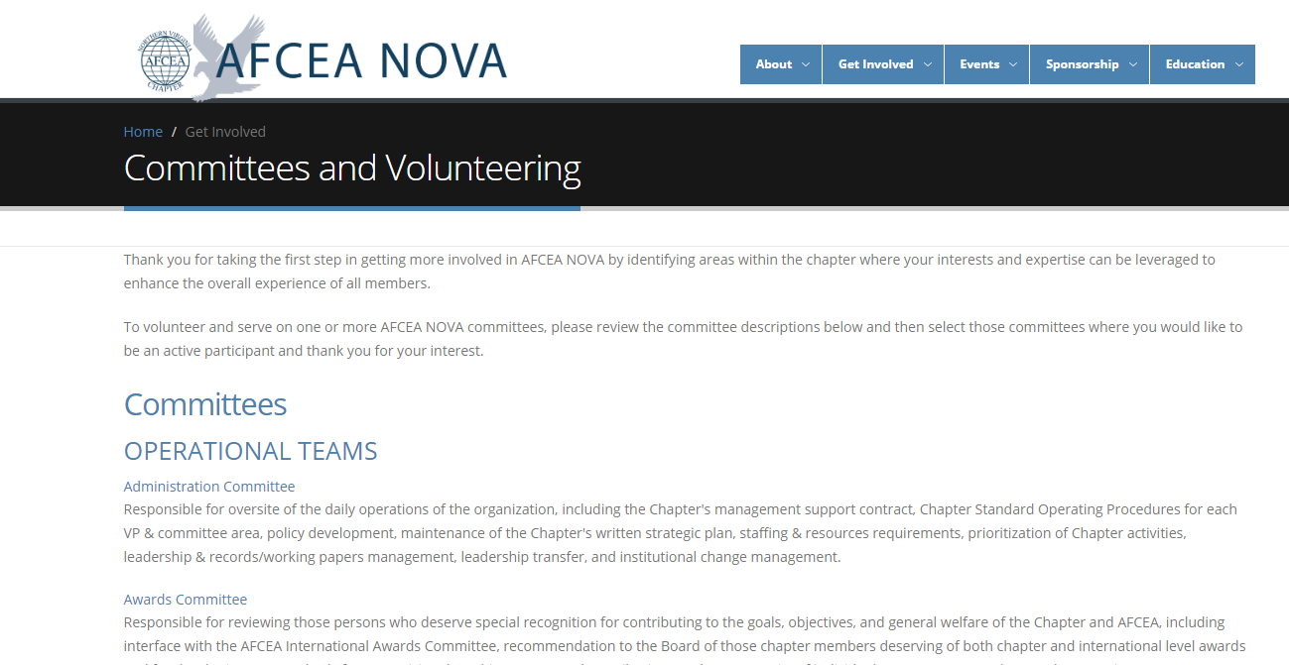
Building Strong Connections
Events hosted at chamber member breweries featured modern casual locations
Social Media Follow up
Events highlighting Board Members and our partnership with Chamber to encourage engagement

Slide 4
Engagement October 2019 to January 2020
Welcome Email
Welcome Email
Welcome Email
Mustang Sally HH
Crooked Run HH

